Slide 1


Introduction to Entity framework
SoftUni Team
ORM Concepts, Entity Framework, DbContext, CRUD Operations
Technical Trainers
Software University
http://softuni.bg

Slide 2


Table of Contents
ORM Technologies – Basic Concepts
Entity Framework – Overview
Reading Data with EF
CRUD operations using Entity Framework
Extending Entity Classes

Slide 3
Questions
sli.do #Entity

Slide 4
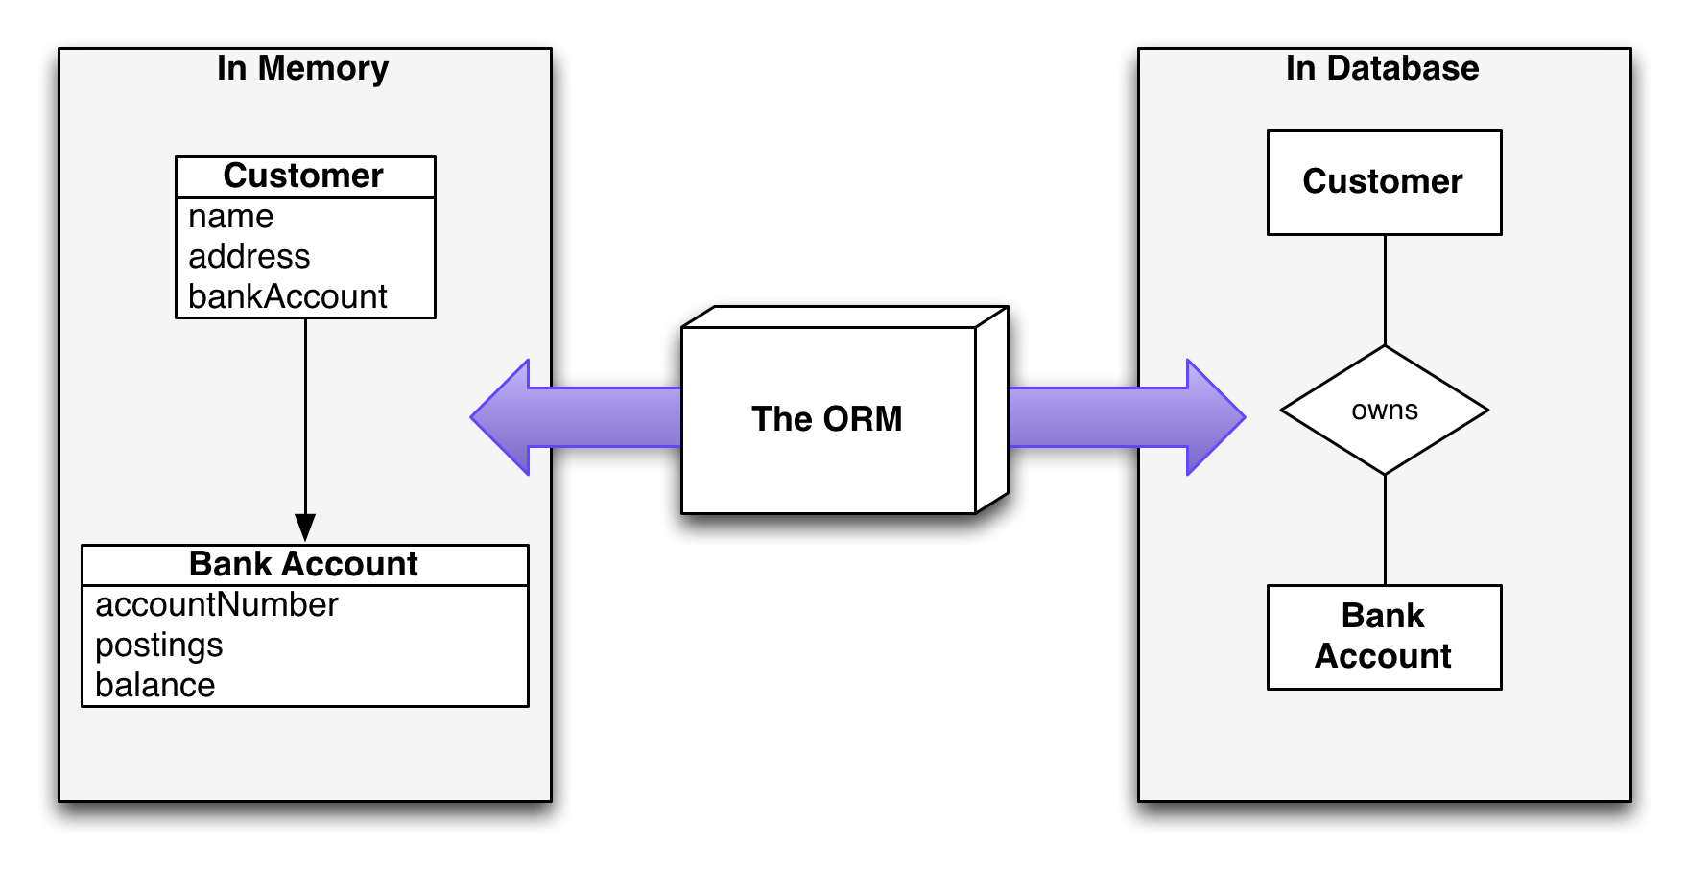

Slide 5
ORM Technologies
Object-Relational Mapping (ORM) is a programming technique for automatic mapping data and schema
Between relational database tables and object-oriented classes and objects
ORM creates a "virtual object database"
Can be used from within the programming language (C# or Java…)
ORM frameworks automate the ORM process
A.k.a. Object-Relational Persistence Frameworks

Slide 6
ORM Frameworks
ORM frameworks typically provide the following functionality:
Creating object model by database schema (DB first model)
Creating database schema by object model (code first model)
Querying data by object-oriented API (e.g. LINQ queries)
Data manipulation operations
CRUD – create, retrieve, update, delete
ORM frameworks automatically generate SQL to perform the requested data operations

Slide 7
ORM Advantages and Disadvantages
Object-relational mapping (ORM) advantages
Developer productivity: writing less code
Abstract from differences between object and relational world
Complexity hidden within the ORM
Manageability of the CRUD operations for complex relationships
Easier maintainability
Disadvantages:
Reduced performance (due to overhead or incorrect ORM use)
Reduces flexibility (some operations are hard for implementing)

Slide 8
ORM Frameworks in .NET
Built-in ORM tools in .NET Framework and VS
Entity Framework (LINQ-to-Entities)
LINQ-to-SQL (Not used)
Both combine entity class mappings and code generation, SQL is generated at runtime
Third party ORM tools
Nhibernate
Telerik OpenAccess ORM

Slide 9


Slide 10
Overview of EF
Entity Framework (EF) is the standard ORM framework for .NET
Provides a run-time infrastructure for managing SQL-based database data as .NET objects
The relational database schema is mapped to an object model
Visual Studio provides built-in tools for generating Entity Framework data models
Data mappings consist of C# classes, XML and attributes
EF provides a powerful data manipulation API
CRUD operations and complex querying with LINQ

Slide 11
Entity Framework Features
Maps tables, views, stored procedures and functions as .NET objects
Provides LINQ-based data queries
Executed as SQL SELECTs on the database server
Parameterized queries
Built-in CRUD operations – Create / Read / Update / Delete
Creating / deleting / upgrading the database schema
Tracks changes to in-memory objects

Slide 12
Entity Framework Features (2)
Works with any relational database
You need an Entity Framework data provider
Work with a visual model, database or with your own classes
Has very good default behavior
Very flexible for more granular control
Open source – independent release cyclegithub.com/aspnet/EntityFramework

Slide 13
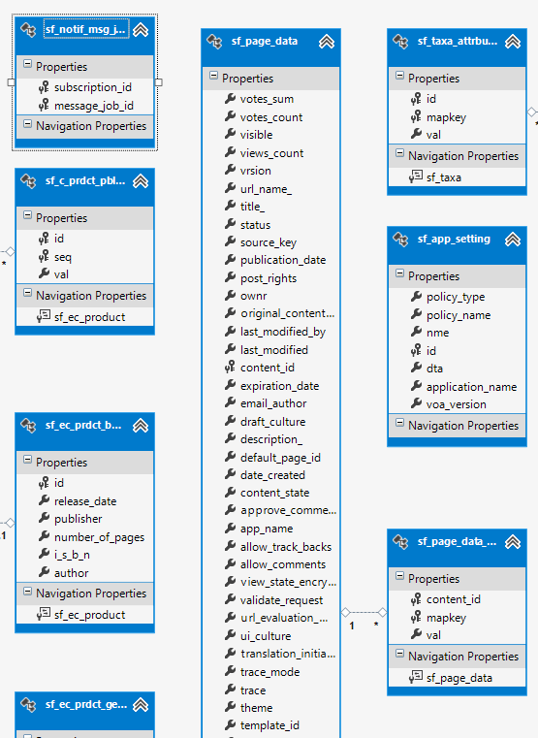
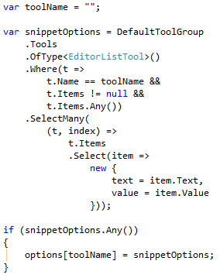
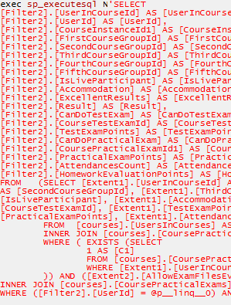
EF: Basic Workflow
Define the data model (use a DB Visual designer or code first)
Write & execute query over IQueryable
EF generates & executes an SQL query in the DB

Slide 14
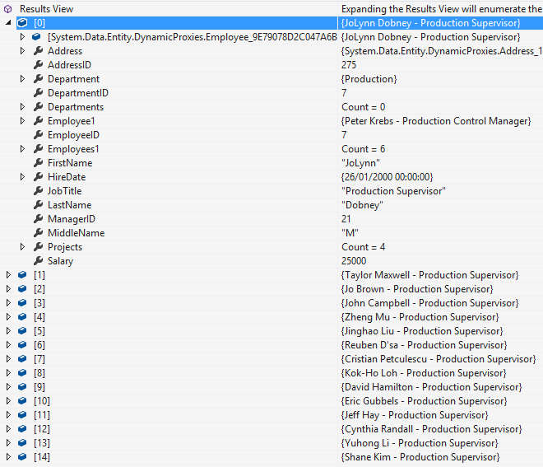
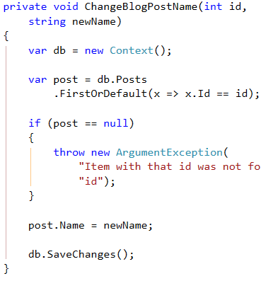
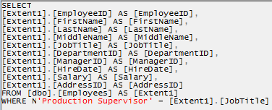
EF: Basic Workflow (2)
EF transforms the query results into .NET objects
Modify data with C# code and call "Save Changes"
Entity Framework generates & executes SQL command to modify the DB

Slide 15
EF Components
The DbContext class
DbContext holds the database connection and the entity classes
Provides LINQ-based data access
Implements identity tracking, change tracking, and API for CRUD operations
Entity classes
Hold entities (objects with their attributes and relations)
Each database table is typically mapped to a single C# entity class

Slide 16
EF Components (2)
Associations (relationship mappings)
An association is a primary key / foreign key-based relationship between two entity classes
Allows navigation from one entity to another
Concurrency control
Entity Framework uses optimistic concurrency control
No locking by default
Automatic concurrency conflict detection
var courses = student.Courses.Where(…);

Slide 17

Reading Data with Entity Framework

Slide 18
The DbContext Class
The DbContext class is generated by the Visual Studio designer
DbContext provides:
Methods for accessing entities (object sets)
Methods for creating new entities (Add() methods)
Ability to manipulate database data though entity classes
Read, modify, delete, insert
Easily navigate through the table relationships
Executing LINQ queries as native SQL queries
Create the DB schema in the database server

Slide 19
Using DbContext Class
First create instance of the DbContext:
In the constructor you can pass a database connection string and mapping source
DbContext properties:
Connection – the SqlConnection to be used
CommandTimeout – SQL commands execution timeout in the DB
All entity classes (tables) are listed as properties
e.g. IDbSet<Employee> Employees { get; }
var softUniEntities = new SoftUniEntities();

Slide 20
Reading Data with LINQ Query
Executing LINQ-to-Entities query over EF entity:
Employees property in the DbContext:
using (var context = new SoftUniEntities())
{ var employees =
from e in context.Employees
where e.JobTitle == "Design Engineer"
select e; }
This will be translated to an SQL query by EF
public partial class SoftUniEntities : DbContext
{
public IDbSet<Employee> Employees { get; set; }
public IDbSet<Project> Projects { get; set; }
public IDbSet<Department> Departments { get; set; }
}

Slide 21
Reading Data with LINQ Query
We can also use extension methods for constructing the query
Find element by id
using (var context = new SoftUniEntities())
{
var employees = context.Employees
.Where(c => c.JobTitle == "Design Engineering")
.Select(c => c.FirstName)
.ToList();
}
This is called projection
ToList() method executes the query
using (var context = new SoftUniEntities())
{
var project = context.Projects.Find(2);
Console.WriteLine(project.Name);
}

Slide 22
Logging the Native SQL Queries
Printing the native database SQL command behind a query:
This will print the SQL native query executed at the database server to select all Employees
Can be printed to file using StreamWriter class instead of Console class
var query = context.Employees;
Console.WriteLine(query.ToString());

Slide 23
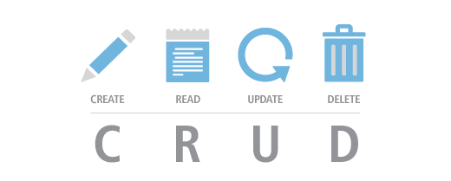
with EF

Slide 24
Creating New Data
To create a new database row use the method Add(…) of the corresponding collection:
SaveChanges() method executes the SQL insert / update / delete commands in the database
Create a new project object
var project = new Project()
{
Name = "Judge System",
StartDate = new DateTime(2015, 4, 15),
};
context.Projects.Add(project);
context.SaveChanges();
Mark the object for inserting
This will execute an SQL INSERT

Slide 25
Cascading Inserts
We can also add cascading entities to the database:
This way we don't have to add Project individually
They will be added when the Employee entity (employee) is inserted to the database
Employee employee = new Employee();
employee.FirstName = "Petya";
employee.LastName = "Grozdarska";
employee.Projects.Add(new Project { Name = "SoftUni Conf"} );
softUniEntities.Employees.Add(employee);
softUniEntities.SaveChanges();

Slide 26
Updating Existing Data
DbContext allows modifying entity properties and persisting them in the database
Just load an entity, modify it and call SaveChanges()
The DbContext automatically tracks all changes made on its entity objects
Employees employee =
softUniEntities.Employees.First();
employees.FirstName = "Alex";
context.SaveChanges();
This will execute an SQL SELECT to load the first order
This will execute an SQL UPDATE

Slide 27
Deleting Existing Data
Delete is done by Remove() on the specified entity collection
SaveChanges() method performs the delete action in the database
Mark the entity for deleting at the next save
Employees employee =
softUniEntities.Employees.First();
softUniEntities.Employees.Remove(employee);
softUniEntities.SaveChanges();
This will execute the SQL DELETE command

Slide 28

Extending Entity Classes
Add Methods like ToString(), Equals(), etc…

Slide 29
Extending Entity Classes
When using "database first" or "model first" entity classes are separate .cs files, generated by T4 template XXXModel.tt
Each time we update the EntitiesModel from the database all files are generated anew
If we add methods like ToString(), they will be lost
Entity classes are "partial" → extend them in another file
When using "code first" this is not a problem

Slide 30

Summary
ORM frameworks maps database schema to objects in a programming language
Facilitates development process
Entity Framework is the standard ORM for C#
Can work with any database if there is provider
Supports CRUD operations with DbContext
Provides LINQ-based data queries
Translated to SQL at runtime
Automatically tracks changes to in-memory objects

Slide 31









Introduction to Entity Framework
https://softuni.bg/courses/

Slide 32
License
This course (slides, examples, demos, videos, homework, etc.) is licensed under the "Creative Commons Attribution-NonCommercial-ShareAlike 4.0 International" license
Attribution: this work may contain portions from
"Databases" course by Telerik Academy under CC-BY-NC-SA license

Slide 33





Free Trainings @ Software University
Software University Foundation – softuni.org
Software University – High-Quality Education, Profession and Job for Software Developers
softuni.bg
Software University @ Facebook
facebook.com/SoftwareUniversity
Software University @ YouTube
youtube.com/SoftwareUniversity
Software University Forums – forum.softuni.bg

